Slide 1


Bringing Cross-Layer MIMO to Today’s Wireless LANs
Swarun Kumar
Diego Cifuentes, Shyamnath Gollakota and Dina Katabi
Notes:
Hi, I am Swarun Kumar from MIT. I am going to talk to you about how to bring cross-layer MIMO to today’s wireless LANs. This is joint work with my colleagues: Diego, Shyam and Dina.

Slide 2
Major Advances in Cross-Layer MIMO
Jointly optimize network protocols & PHY
Big gains in throughput and reliability
Deal with Interference
Improve SNR
Nulling
Alignment
Beamforming
Built using software radios in real settings
None of these techniques run on today’s Wi-Fi cards!
Notes:
Recent years have seen major advances in Cross-Layer MIMO designs.
Such systems have opened our eyes to the benefits of jointly optimizing higher-layer network protocols with low-level PHY signal processing.
And have demonstrated big gains in network throughput and reliability.
For instance, some like nulling or alignment improve throughput by dealing with interference.
Others like beamforming, improve the signal to noise ratio to enable more reliable transmission.
Recent SIGCOMM papers have actually built these techniques using software radios in real indoor settings.
Unfortunately, none of these techniques actually run on today’s Wi-Fi cards!

Slide 3
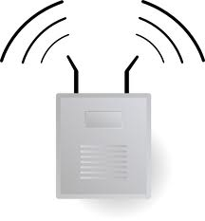

Why is This an Important Issue?
impact
Researchers
AP
Build techniques
into hardware &
standards
Use Commodity
Wi-Fi Cards
Chip Manufacturers
None of these techniques tested on real applications in real networks
How do they affect..
802.11
TCP
bursty traffic
….
Notes:
So why is this an important issue?
Today’s WiFi Access Points are built over commodity Wi-Fi cards.
So for researchers to make impact on today’s networks….
They must persuade chip manufacturers to flush the entire pipeline of building these techniques into hardware and standards.
However chip manufacturers recognize that none of these techniques have been tested on real applications in real networks.
As a result they hesitate to make big hardware investments .. until they fully understand of how these techniques affect 802.11, TCP and bursty network traffic, etc.

Slide 4
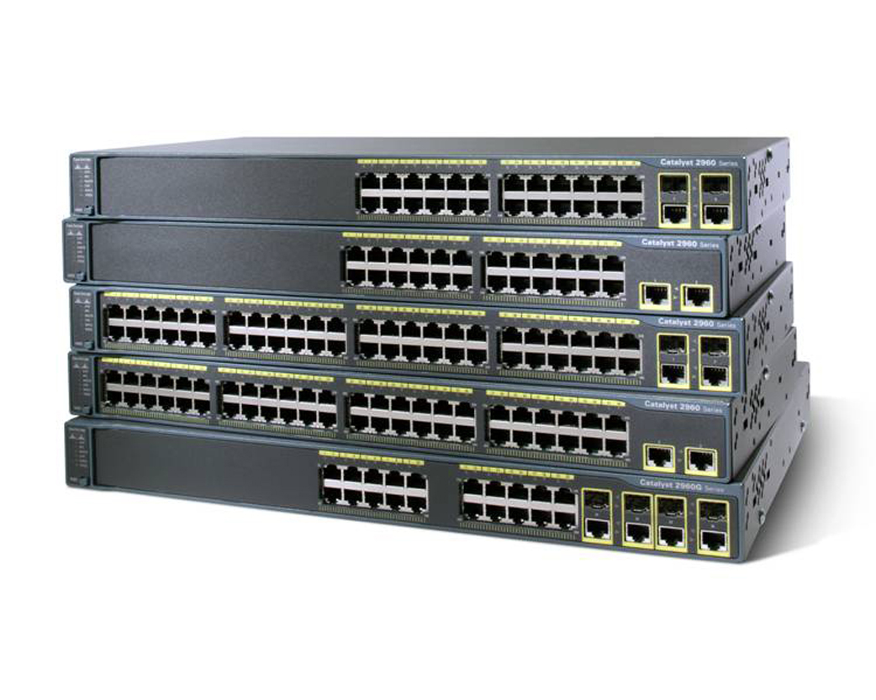
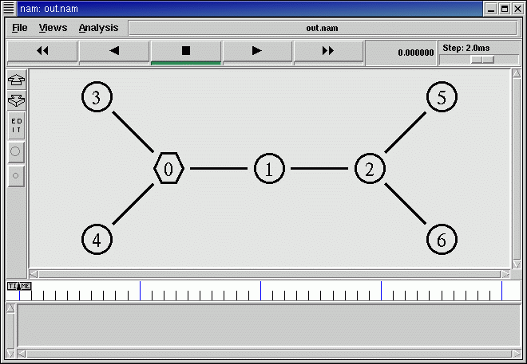
A Similar Picture in Wired Networks
Researchers
Build techniques
into hardware &
standards
Commodity
Switches
Switch Manufacturers
How do they impact real networks?
Deploy innovations in commodity hardware
Small test-beds or ns simulator
OpenFlow, SDNs pioneered this path
Can we achieve the same in wireless networks?
Notes:
This reminds us of a similar picture 10 years ago in the wired networking community.
Back then, internet protocols were developed in small testbeds or the ns simulator and were hardly adopted by switch manufacturers.
Wired networks broke this stalemate by building innovations over commodity hardware and directly deploying them in real networks.
OpenFlow and the large body of work on Software Defined networks have pioneered this path.
So the key question is if we can achieve the same in wireless networks.

Slide 5
OpenRF
Brings MIMO techniques to today’s Wi-Fi cards
Nulling, Alignment and Beamforming
Addresses challenges in interactions with 802.11, TCP, bursty traffic and real apps
Self-configures MIMO techniques to benefit any network scenario
Admins do not need to understand MIMO processing
Notes:
In the rest of this talk, I will introduce OpenRF, which takes the first step towards this goal.
OpenRF brings cross layer MIMO techniques to today’s Wi-Fi cards.
In particular it implements interference nulling, interference alignment, coherent beamforming and different combinations of these techniques.
It reveals and addresses challenges in how they interact with 802.11, TCP, bursty traffic and real applications.
OpenRF also self-configures the correct combination of MIMO techniques to benefit any network scenario.
Hence network administrators can benefit from these techniques without understanding the underlying details of MIMO signal processing.

Slide 6
OpenRF’s Goals
Control downlink traffic from APs to clients
Ethernet
Controls Access Points to apply PHY techniques
OpenRF
OpenRF
AP-1
AP-2
Clients not controlled
Alice
Bob
Notes:
Let’s first understand what OpenRF aims to achieve in a wireless network.
We consider a simple example where we have two access points : AP-1 and AP-2 connected by a wired backbone.
Let’s say that the APs serve two clients Alice and Bob.
Essentially, OpenRF aims to control downlink traffic from APs to clients.
In other words, it provides a software layer that controls each Access Point in the network to apply PHY techniques.
The clients however are independent devices that we do not coordinate or control.

Slide 7


OpenRF’s Goals
Ethernet
OpenRF
OpenRF
AP-1
AP-2
Alice
Alice
Alice
Alice
6 Mbps
time
Alice
Bob
Notes:
Now let’s suppose Alice decides to start watching a High-Definition Youtube video.
Let’s say AP-1 sends packets to Alice at 6 Mbps, which is just about enough for good quality.
Now suppose Bob decides to watch a video as well!
Unfortunately, the wireless medium is shared …

Slide 8

OpenRF’s Goals
Ethernet
OpenRF
OpenRF
AP-1
AP-2
Alice
Alice
3 Mbps
3 Mbps
Bob
Bob
time
Alice
Bob
Buffering…
Buffering…
Notes:
… So, Alice and Bob are forced to take turns on the medium,
Thus, they only get half their earlier share, that is 3 Mbps each.
And this deteriorates the quality of service for both users.

Slide 9
OpenRF’s Goals
“Interference Nulling”
Ethernet
OpenRF
OpenRF
AP-1
AP-2
3 Mbps
3 Mbps
null
null
Alice
Bob
Buffering…
Buffering…
Notes:
To tackle this problem, OpenRF leverages a technique called interference nulling.
Essentially, AP-2 can leverage its multiple antennas to cancel any interference at Alice.
Similarly AP-1 cancels interference at Bob.

Slide 10
OpenRF’s Goals
“Interference Nulling”
Ethernet
OpenRF
OpenRF
AP-1
AP-2
3 Mbps
3 Mbps
null
null
Alice
Bob
Buffering…
Buffering…
Notes:
In effect, this technique uses the multiple antennas on the AP to re-direct the interfering beams away from the clients.

Slide 11
OpenRF’s Goals
“Interference Nulling”
Ethernet
OpenRF
OpenRF
AP-1
AP-2
Alice
Alice
Alice
Alice
6 Mbps
6 Mbps
Bob
Bob
Bob
Bob
null
null
time
Alice
Bob
HD Quality!
HD Quality!
Notes:
This enables AP-1 and AP-2 to transmit simultaneously and hence go back to 6 Mbps each.
Thus they can both enjoy HD quality videos.

Slide 12
OpenRF’s Goals
“Beamforming”
Ethernet
OpenRF
OpenRF
AP-1
AP-2
6 Mbps
3 Mbps
beamform
null
null
Alice
Bob
Notes:
But now let’s say Bob walks farther away from AP-2,
… so his throughput drops to 3 Mbps.
In this case, OpenRF can apply another technique “coherent beamforming” to maximize received signal power to Bob.

Slide 13
OpenRF’s Goals
Ethernet
OpenRF
OpenRF
AP-1
AP-2
6 Mbps
6 Mbps
beamform
null
null
Alice
OpenRF must self-configure to network dynamism
Bob
Notes:
Essentially this leverages the AP’s antennas to focus the beam and maximize received power at Bob.
In effect, this can push Bob’s rate back to its original 6 Mbps.
Hence, OpenRF must be able to apply the right set of MIMO techniques to self-configure to such dynamism in the network.

Slide 14
OpenRF’s Architecture
Control Plane
OpenRF Interface
Ethernet
Flow-id
Action
OpenRF
OpenRF
AP-1
AP-2
Data Plane
PHY
techniques
null
null
Alice
Bob
Notes:
So let’s see how OpenRF’s architecture achieves this goal.
At the heart of OpenRF is an interface that separates the data and control plane.
The interface operates over a (flowid, action) table much like OpenFlow. In an OpenFlow switch, the action refers to an output port along which a flow must be forwarded.
In contrast, an OpenRF action refers to the PHY techniques that an AP applies to a flow.

Slide 15
OpenRF’s Architecture
Control Plane
OpenRF Interface
Ethernet
Flow-id
Action
OpenRF
To:Bob
beamform @Bob
null @Alice
OpenRF
AP-1
AP-2
Data Plane
beamform
null
null
Alice
Bob
Notes:
For example, the control plane may ask AP-2 to beamform any packet to Bob, while nulling it at Alice.
The interface then feeds this information to the data plane….

Slide 16
OpenRF’s Architecture
Control Plane
OpenRF Interface
Ethernet
Flow-id
Action
OpenRF
To:Bob
beamform @Bob
null @Alice
OpenRF
AP-1
AP-2
Data Plane
beamform
null
null
Alice
Bob
Notes:
… which redirects the signal beam to apply these techniques.
In other words, an action in OpenRF refers to the spatial direction along which a signal must be forwarded.

Slide 17
OpenRF’s Architecture
Control Plane
OpenRF Interface
Ethernet
Flow-id
Action
OpenRF
To:Bob
beamform @Bob
null @Alice
OpenRF
AP-1
AP-2
Data Plane
beamform
null
null
Alice
In OpenRF, action = spatial direction to forward signal
Bob
Notes:
… which redirects the signal beam to apply these techniques.
In other words, an action in OpenRF refers to the spatial direction along which a signal must be forwarded.

Slide 18
Challenges
1. Data Plane: Apply PHY techniques to commodity 802.11 cards
2. Control Plane: Self-configure to network dynamism
Notes:
So to build such an architecture, we need to address two challenges.
First, we need to build a data plane to apply PHY techniques to commodity Wi-Fi cards.
Second, we need a control plane that self-configures to network dynamism.
Let’s start with how we can apply PHY techniques to commodity cards.

Slide 19
Bringing PHY-Techniques to Commodity Cards
PHY techniques need to manipulate channels
OpenRF enables channel manipulation
Constraints due to 802.11n standard:
In cards: 3 bits/subcarrier (USRPs: 14 bits/subcarrier)
Only manipulates alternate subcarriers
Accepts only unitary beamforming matrix
Notes:
PHY techniques need to manipulate wireless channels to spatially redirect a signal.
So we devised a mechanism to manipulate the channels. I won’t be delving into the precise details for this talk ….
But this involved three constraints due to the 802.11n standard.
First, it could only set 3 bits per subcarrier for each antenna, as against 14 bits for software radios like USRPs.
Second, it could only manipulate alternate OFDM subcarriers.
Finally, it accepted only unitary matrices for beamforming.

Slide 20
Can PHY-Techniques Work Despite Constraints?
OpenRF
AP
null
Client
Notes:
So, at this point, we were wondering if PHY techniques can work on commodity cards, despite these constraints.
So we went ahead and built our system on a 3-antenna Access Point.
We then made this access point null its interference at a single antenna client.

Slide 21
Can PHY-Techniques Work Despite Constraints?
-12 dB
Interference After Nulling (dB)
Interference Before Nulling (dB)
Reduction of 12 dB makes a 24 Mbps source disappear!
Notes:
We then measure the interference at the client before nulling against the interference after nulling.
In the absence of nulling, the interference will not change, so we will observe points along the x=y line.
Here are the results with nulling. As you can see, the interference after nulling has a drop of 12 dB compared to INR without nulling.
To put this in perspective, this means an access point that could earlier send at 24 Mbps now virtually disappears!

Slide 22
Let’s See How This Impacts a Network
OpenRF
OpenRF
AP-1
AP-2
null
null
Alice
Bob
Notes:
So let’s see how this impacts the performance of a real network!
We consider a system with 2 commodity APs and 2 clients.
We then make AP-1 null its signal to Alice
And AP-2 null its signal to Bob.
So that AP-1 and AP-2 to transmit concurrently without interfering with each other.

Slide 23
Let’s See How This Impacts a Network
AP1
Alice
Alice
Alice
Alice
AP2
Bob
Bob
Bob
Bob
time
At PHY layer, OpenRF achieves 2× gain
But will we still see this gain with full network stack?
Notes:
As a result, Alice and Bob can get their packets at the exact same time.
So at the PHY layer, OpenRF should achieve a 2x gain in throughput.
But will we still see this gain with a full network stack?

Slide 24
OpenRF With Full Network Stack
We didn’t observe any gain!
802.11 APs use carrier sense
→ Never send at same time!
AP1
Alice
Alice
AP2
Bob
Bob
time
Notes:
To test this, we implemented our system with the full network stack.
And surprisingly, we did not observe any gain!
The reason is that 802.11 APs use carrier sense.
In other words, they are designed to never send packets at the exact same time.

Slide 25
Naïve approach: Disable Carrier Sense
Can’t be nulled
AP1
Alice
Alice
Alice
beacon
AP2
Bob
Bob
Bob
beacon
other 802.11 packet
time
Can we have concurrent & non-concurrent packets
without disabling carrier sense?
Notes:
Of course, one naïve approach is to simply disable carrier sense on both APs.
This will make them transmit in parallel because they simply do not sense each other.
But suppose there’s a stray 802.11 packet from a neighboring network.
Unfortunately, the APs will now collide with this packet, since they did not actually sense it.
But there’s yet another problem. APs often send beacon packets on the medium.
Such beacons are meant for all clients, so they cannot be nulled at any client.
Unfortunately, such packets will now also collide on the medium.
So how can we have a mix of such concurrent and non-concurrent packets, without disabling carrier sense?

Slide 26
How can APs Send Mix of Concurrent and Non-Concurrent Packets?
AP1
Alice
beacon
AP2
Bob
beacon
sense
sense
time
Notes:
Let’s say somebody just sent a packet on the medium.
Ideally, we want AP1 and AP2 to synchronize their carrier sense, so that they sense the medium as idle for the exact same amount of time.
So that they APs will send their packets to Alice and Bob concurrently.
However, when the APs want to send beacon packets, they will perform the usual carrier sense for different amounts of time.
As a result, one of them wins access to the medium, and they will end up transmitting sequentially.

Slide 27
Solution: Two Transmit Queues
beacon
Alice
beacon
Alice
Usual Carrier Sense
Synchronized Carrier Sense
“Arbitrary Inter-Frame Spacing” (AIFS)
Alice
Alice
Alice
Bob
Bob
Bob
other 802.11 packet
time
{
{
OpenRF maintains reliability mechanisms of 802.11
AIFS
AIFS
Notes:
So the solution is to leverage two transmit queues at the AP.
The first queue is meant for beacon packets and uses regular carrier sense.
The second queue is used for packets whose carrier sense must be synchronized with other APs.
To do this we use a feature – Arbitrary inter-frame spacing present in most 802.11n cards today.
This feature allows us to force both AP-1 and AP-2 to perform carrier sense for the exact duration of time same time.
So the APs send their packets to Alice and Bob in tandem.
Further even if their transmission is interrupted by a stray 802.11 packet, …
They will sense it and resume sending simultaneously after AIFS seconds from the end of the packet.
Thus, this makes sure OpenRF achieves its goals while maintaining the reliability mechanisms of 802.11.

Slide 28
Challenges
1. Data Plane: Apply PHY techniques to commodity 802.11 cards
2. Control Plane: Self-configure to network dynamism
Notes:
So now that we understand the data plane, let’s move on to the control plane.

Slide 29
Past PHY Papers Shown in Specific Topologies
Small toy test-beds, where scalability is not an issue
Fixed flows → no changing traffic patterns
OpenRF must be robust to dynamism
in real large networks
Notes:
Most prior work on PHY techniques have been shown in specific topologies.
They are built on small toy test-beds, where scalability is not an issue.
And they assume fixed traffic flows and do not consider changing traffic patterns.
But OpenRF needs to work in large networks, so it must be scalable and robust to dynamic traffic patterns.

Slide 30
OpenRF Controller
OpenRF
Controller
Wireless Channels
→ Interference Graph
Configures interface to apply PHY techniques
OpenRF
OpenRF
AP
AP
Naïve controller: Globally Schedule all flows
But, high overhead!
Client
Client
Client
Client
Notes:
To do this, we have an OpenRF controller that manages the control plane, like in software-defined networks.
The controller takes as input the wireless channel that the access points measure to different clients in the network. They can use this to find out who interferes with who and generate an interference graph.
The controller then configures the OpenRF interface on the APs to apply the correct set of PHY techniques at various points in time.
A naïve controller can simply globally schedule all flows in the network.
Of course, this leads to high overhead.

Slide 31
Solution: Offload Some Scheduling Locally
MIMO techniques
Coherence Techniques
Interference Techniques
(e.g. beamforming)
(e.g. nulling, alignment)
AP improves signal quality to its own client
AP needs another AP to cancel interference at client
OpenRF
OpenRF
AP-1
AP-2
Only edge clients needing interference techniques are scheduled a priori by a central controller
Rest can be scheduled locally based on traffic patterns
beamform
null
Alice
Bob
Notes:
The solution that OpenRF adopts is offload some of the scheduling to the access points.
To see how this is possible, we observe that PHY techniques can be decoupled as coherence and interference techniques.
In a coherence techniques, like beamforming, an AP wants to improve signal quality to its own client.
So there’s really no need to coordinate with any other neighboring AP.
In contrast, for an interference technique the AP needs another AP to cancel interference at its client
So the AP must coordinate transmission with the other AP.
In this example, Bob is an edge client at the intersection of interference region of AP-1 and AP-2.
So whenever AP-1 transmits to Bob, it must ensure that AP-2 nulls its interference at Bob.
Hence, OpenRF’s controller follows two key design principles.
First, only these edge clients that need interference techniques are scheduled a priori by a central controller.
All other traffic can be scheduled locally in real time based on dynamic traffic patterns.

Slide 32
Efficient Scheduling with Dynamic Traffic
Central controller schedules a client for some time-slot
At that slot, AP has no packets in queue for the client
The slot is wasted by the AP!
Notes:
Another goal of the controller is to make sure that the scheduling is efficient even with dynamic traffic patterns.
To see why this is important, suppose the central controller schedules a client for some time slot.
But come that time slot, the AP did not have packets in the queue for that particular client.
So unless we do something about this, the AP wastes this slot.

Slide 33
Efficient Scheduling with Dynamic Traffic
OpenRF
Controller
OpenRF
OpenRF
AP-1
AP-2
Chris
Alice
Bob
Notes:
Let’s see what this means in our previous example.
Here Bob is an edge client.

Slide 34
Efficient Scheduling with Dynamic Traffic
Observation: APs can dynamically re-allocate slots for edge-clients to non-edge clients
→ Prevents wasted slots
OpenRF
Controller
Alice
Alice
OpenRF
OpenRF
AP-1
AP-2
null
Chris
Alice
Bob
Notes:
So let’s say, AP1 was scheduled by the central controller to transmit to Bob in some slot.
And AP2 agrees to null its signal at Bob for that slot.
But come that slot, it turns out that all packets in AP-1’s queue were for Alice instead.
So how do we make sure that AP-1 does not just waste this slot?
A key observation here is that in such situations, APs can dynamically reallocate central slots to other non-edge clients.
This prevents wastage of slots.

Slide 35
Efficient Scheduling with Dynamic Traffic
Observation: APs can dynamically re-allocate slots for edge-clients to non-edge clients
→ Prevents wasted slots
OpenRF
Controller
Alice
Alice
OpenRF
OpenRF
AP-1
AP-2
null
Chris
Re-allocation must ensure fairness between flows
In the paper, we show how to build deficit round robin schedulers to do this
Alice
Alice
Bob
Notes:
In this example, AP-1 can re-allocate its slot to Alice. Note that AP-2 will still null to Bob In this slot, but this does not affect Alice in any way.
Of course, any such reallocation must ensure fairness between flows.
In the paper, we show how to build deficit round robin schedulers to do this.

Slide 36
Experimental Results
Notes:
Now that we understand how OpenRF works, lets see how it performs in practice.

Slide 37
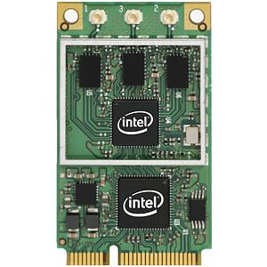
OpenRF Implementation
Implemented on Intel 5300 Wi-Fi cards
Modified the iwlwifi driver for Linux
Extended the 802.11 CSI tool to manipulate wireless channels
Compare OpenRF with standard 802.11n baseline
Notes:
We implemented OpenRF on Intel 5300 Wi-Fi cards.
We modified the iwlwifi Intel driver to support the OpenRF interface.
We extended the 802.11 CSI tool from the University of Washington to manipulate wireless channels.
We compare OpenRF with a standard 802.11n baseline.

Slide 38
Interference Nulling
TCP Throughput
-12 dB
Interference After
Nulling (dB)
Avg. gain = 1.7 ×
Interference Before Nulling(dB)
Notes:
Let’s first look at interference nulling.
Recall that we observed that nulling allowed a reduction in interference by 12 dB.
So let’s see how this translates to throughput for TCP flows. We plot the CDF of the network throughput for traffic across experiments.
Here are the results.
As you can see OpenRF achieves a 1.7x gain in throughput compared to the baseline 802.11.

Slide 39
Interference Alignment
-11 dB
Interference After Alignment (dB)
Interference Before Alignment (dB)
Notes:
Next, we look measure the similar reduction in interference for interference alignment.
Our results show that the reduction achieved is 11 dB.

Slide 40
Interference Alignment
TCP Throughput
Avg. gain = 1.6 ×
-11 dB
Interference After Alignment (dB)
Interference Before Alignment (dB)
OpenRF achieves similar gains for beamforming as well
Notes:
Let’s see how this translates to the throughput for TCP flows.
The CDF demonstrates that OpenRF achieves a gain of 1.6x across experiments.
In the paper we show how OpenRF achieves similar gains for beamforming as well.

Slide 41
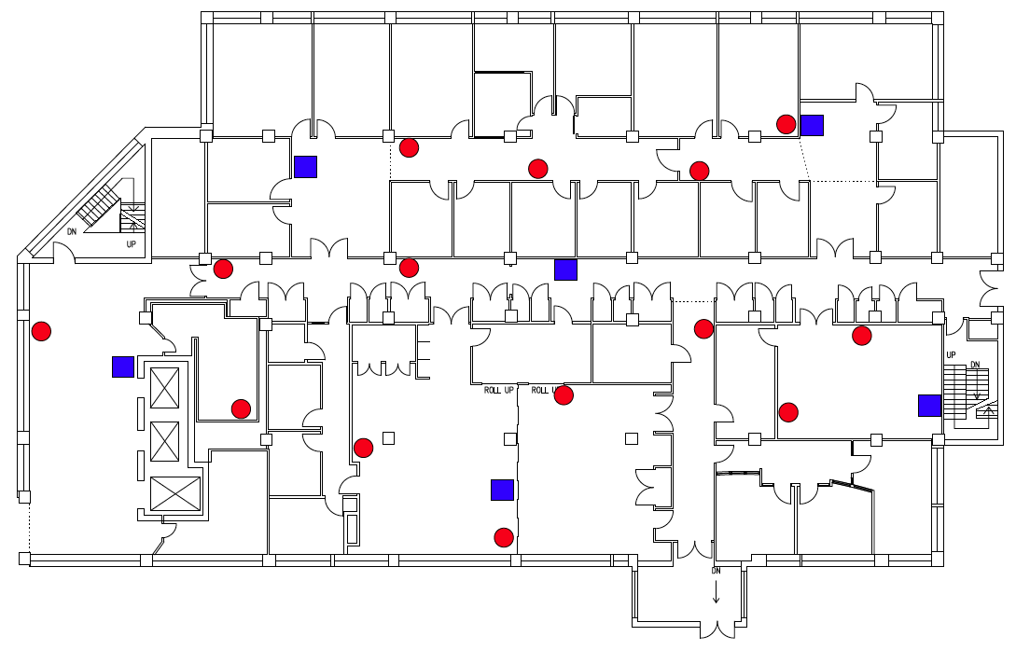
Large Scale Experiment
20 node testbed: 6 APs, 14 clients
APs are 3-antennas nodes
Clients are a mix of 1, 2 and 3-antenna nodes
Measure throughput for TCP flows
APs
Clients
Notes:
Next, we evaluate how OpenRF improves network throughput in a large testbed.
We evaluated OpenRF on a 20 node testbed: 6 chosen as APs and 14 as clients.
The APs are 3-antenna nodes.
The clients are a mix of single, two antenna and three antenna devices.
We measure throughput for TCP flows generated using iperf.

Slide 42
Large Scale Experiment
OpenRF provides 1.6x gain in TCP throughput
Notes:
We plot the throughput with 802.11 and OpenRF for different clients in the network.
Here are the results.
We observe that OpenRF provides a 1.6x gain in throughput over 802.11.
Hence, we show for the first time that applying MIMO techniques can provide gains for TCP flows

Slide 43


Real Applications
Two clients watch video over VLC
802.11
Blue
Red
Frame Delay (ms)
OpenRF
Blue
Red
Frame Delay (ms)
Notes:
Finally, we measure the impact of OpenRF for real applications.
We consider two clients streaming a HD video over VLC.
We compare the delays in the video for 802.11 and OpenRF.
Here are the results.
For 802.11, the delays remain low when the blue client is the only client in the network, but clearly begin to spike once the red client joins the network.
In contrast, the delays remain low for OpenRF even when both clients are streaming video at the same time.
Let’s look at how this translates to Bob’s actual video experience. We start with 802.11
(Play)
As you can see the video suffers from major glitches and stalls. Next let’s look at OpenRF.
(Play)
Clearly the video is of much better quality!

Slide 44
Conclusion
Enables deployment of PHY-layer MIMO techniques on commodity Wi-Fi cards
Achieves gains over fully operational network stack with real applications
First steps towards opening up PHY research to a wider community
Notes:
To conclude.
I presented OpenRF, a cross-layer architecture that enables deploying PHY techniques on commodity Wi-Fi cards.
OpenRF achieves gains over a fully operational network stack with real applications.
And we believe OpenRF takes the first steps towards opening up PHY research to a wider community.

